Slide 1

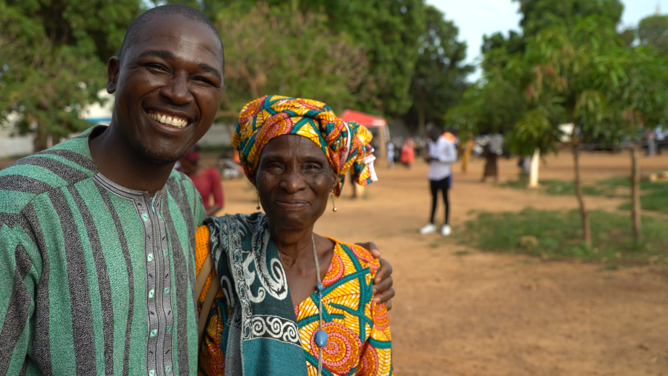

FireBible
Bringing the Fire of God's Word
to the Human Heart

